Slide 1

Week 10 - Lecture
ACN –Mobile Communication Systems and
Self Organising Networks
Enda Stafford
Notes:
Original Slides : Sean Bonner

Slide 2
Agenda
Mobile Communication systems
Current Mobile Network Generations

Slide 3

Mobile Communication Systems

Slide 4
What is Mobile communication?
Mobile communication is the use of technology that allows us to communicate with others in different locations without the use of any physical connection (wires or cables).
Examples:
SMS: stands for “Short Message Service.” It is now the most widely used and oldest text messaging service.
MMS: MMS (Multimedia Messaging Service) messaging is a standard method of delivering multimedia material, including messages.
3G: 3G stands for third-generation access technology, which allows mobile phones to connect to the internet
4G: The fourth generation of mobile networking technology is known as 4G, which comes after the 2G and 3G networks. Although it’s commonly referred to as 4G LTE, this isn’t exactly right because LTE is just one sort of 4G.

Slide 5
GSM Global System for Mobile technology: The (GSM) is an acronym for Global System for Mobile Communication.
GSM is a cellular technology that is open and digital and is used for mobile communication.
It operates on the 850 MHz, 900 MHz, 1800 MHz, and 1900 MHz frequency ranges. It employs a hybrid of FDMA and TDMA.
What is FDMA and TDMA?
The term FDMA is an acronym for Frequency Division Multiple Access. The term TDMA is an acronym for Time Division Multiple Access. The term CDMA is an acronym for Code Division Multiple Access.
Mode of Operation. FDMA shares one single bandwidth among various stations by splitting it into sub-channels.

Slide 6
Code Division Multiple Access: (CDMA) is an acronym for code division multiple access. It is a channel access mechanism that also serves as an example of multiple access.
Multiple access simply means that data from multiple transmitters can be delivered onto a single communication channel at the same time
Wi-Fi (Wireless Fidelity): Wi-Fi is a wireless networking technology that allows us to connect to a network or to other computers or mobile devices across a wireless channel.
Data is delivered in a circular region over radio frequencies in Wi-Fi. Wi-Fi is a generic acronym for a communication standard for a wireless network that functions as a Local Area Network without the use of cables or other types of cabling.

Slide 7
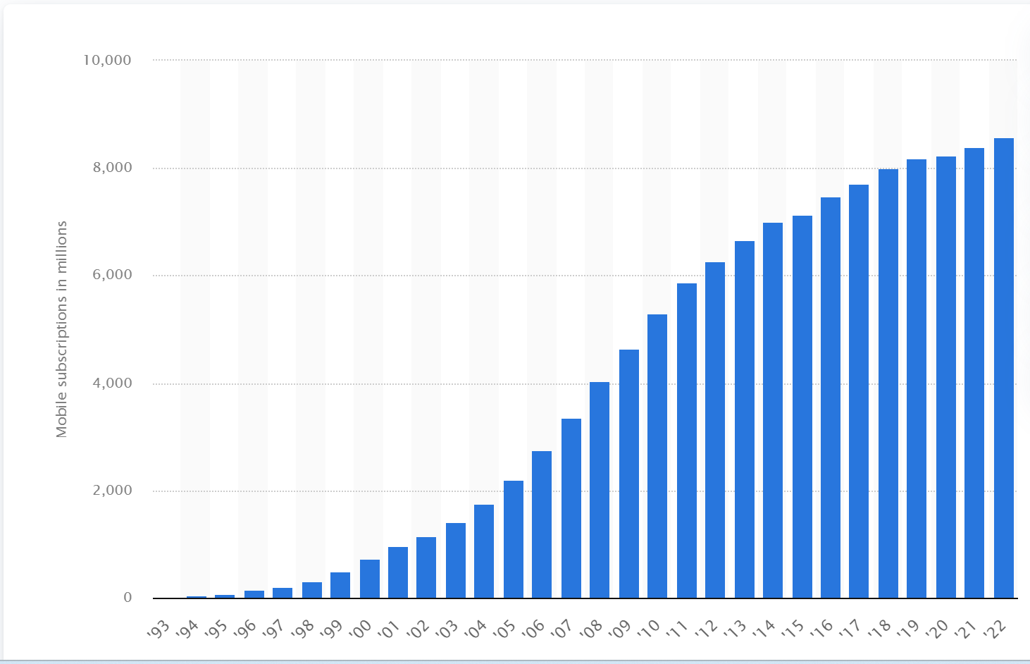
Number of mobile (cellular) subscriptions worldwide from 1993 to 2022
(in millions)

Slide 8
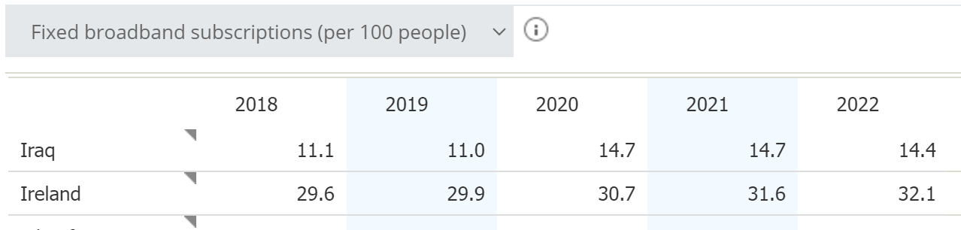
https://databank.worldbank.org/reports.aspx?dsid=2&series=IT.NET.BBND.P2

Slide 9
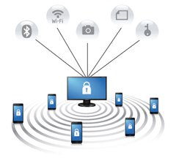
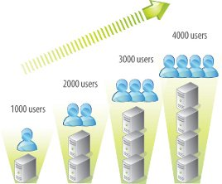
Features of Mobile communication
High Capacity
Scalability
Network Management Systems
Role based access control
Indoor and outdoor coverage
Network access control
Mobile device management
Roaming
Redundancy
Security
Notes:
The following are the features of mobile communication:
High capacity load balancing: Each wired or wireless infrastructure must incorporate high capacity load balancing. High capacity load balancing means, when one access point is overloaded, the system will actively shift users from one access point to another depending on the capacity which is available.
Scalability: The growth in popularity of new wireless devices continuously increasing day by day. The wireless networks have the ability to start small if necessary, but expand in terms of coverage and capacity as needed - without having to overhaul or build an entirely new network.
Network management system: Now a day, wireless networks are much more complex and may consist of hundreds or even thousands of access points, firewalls, switches, managed power and various other components. The wireless networks have a smarter way of managing the entire network from a centralized point.
Role based access control: Role based access control (RBAC) allows you to assign roles based on what, who, where, when and how a user or device is trying to access your network. Once the end user or role of the devices is defined, access control policies or rules can be enforced.Indoor as well as outdoor coverage options: It is important that your wireless system has the capability of adding indoor coverage as well as outdoor coverage.
Network access control: Network access control can also be called as mobile device registration. It is essential to have a secure registration. Network access control (NAC) controls the role of the user and enforces policies. NAC can allow your users to register themselves to the network. It is a helpful feature that enhances the user experience.
Mobile device management: Suppose, many mobile devices are accessing your wireless network; now think about the thousands of applications are running on those mobile devices. How do you plan on managing all of these devices and their applications, especially as devices come and go from your business? Mobile device management can provide control of how you will manage access to programs and applications. Even you can remotely wipe the device if it is lost or stolen.
Roaming: You don't need to worry about dropped connections, slower speeds or any disruption in service as you move throughout your office or even from building to building wireless needs to be mobile first. Roaming allows your end-users to successfully move from one access point to another without ever noticing a dip in a performance. For example, allowing a student to check their mail as they walk from one class to the next.
Redundancy: The level or amount of redundancy your wireless system requires depends on your specific environment and needs.
For example: A hospital environment will need a higher level of redundancy than a coffee shop. However, at the end of the day, they both need to have a backup plan in place.
Proper Security means using the right firewall: The backbone of the system is your network firewall. With the right firewall in place you will be able to:
See and control both your applications and end users.
Create the right balance between security and performance.
Reduce the complexity with:
Antivirus protection.
Deep Packet Inspection (DPI)
Application filtering
Protect your network and end users against known and unknown threads including:
Zero- day.
Encrypted malware.
Ransomware.
Malicious botnets.

Slide 10
Features
High capacity load balancing: Each wired or wireless infrastructure must incorporate high capacity load balancing. High capacity load balancing means, when one access point is overloaded, the system will actively shift users from one access point to another depending on the capacity which is available.
Scalability: The growth in popularity of new wireless devices continuously increasing day by day. The wireless networks have the ability to start small if necessary, but expand in terms of coverage and capacity as needed - without having to overhaul or build an entirely new network.
Notes:
The following are the features of mobile communication:
High capacity load balancing: Each wired or wireless infrastructure must incorporate high capacity load balancing. High capacity load balancing means, when one access point is overloaded, the system will actively shift users from one access point to another depending on the capacity which is available.
Scalability: The growth in popularity of new wireless devices continuously increasing day by day. The wireless networks have the ability to start small if necessary, but expand in terms of coverage and capacity as needed - without having to overhaul or build an entirely new network.
Network management system: Now a day, wireless networks are much more complex and may consist of hundreds or even thousands of access points, firewalls, switches, managed power and various other components. The wireless networks have a smarter way of managing the entire network from a centralized point.
Role based access control: Role based access control (RBAC) allows you to assign roles based on what, who, where, when and how a user or device is trying to access your network. Once the end user or role of the devices is defined, access control policies or rules can be enforced.Indoor as well as outdoor coverage options: It is important that your wireless system has the capability of adding indoor coverage as well as outdoor coverage.
Network access control: Network access control can also be called as mobile device registration. It is essential to have a secure registration. Network access control (NAC) controls the role of the user and enforces policies. NAC can allow your users to register themselves to the network. It is a helpful feature that enhances the user experience.
Mobile device management: Suppose, many mobile devices are accessing your wireless network; now think about the thousands of applications are running on those mobile devices. How do you plan on managing all of these devices and their applications, especially as devices come and go from your business? Mobile device management can provide control of how you will manage access to programs and applications. Even you can remotely wipe the device if it is lost or stolen.
Roaming: You don't need to worry about dropped connections, slower speeds or any disruption in service as you move throughout your office or even from building to building wireless needs to be mobile first. Roaming allows your end-users to successfully move from one access point to another without ever noticing a dip in a performance. For example, allowing a student to check their mail as they walk from one class to the next.
Redundancy: The level or amount of redundancy your wireless system requires depends on your specific environment and needs.
For example: A hospital environment will need a higher level of redundancy than a coffee shop. However, at the end of the day, they both need to have a backup plan in place.
Proper Security means using the right firewall: The backbone of the system is your network firewall. With the right firewall in place you will be able to:
See and control both your applications and end users.
Create the right balance between security and performance.
Reduce the complexity with:
Antivirus protection.
Deep Packet Inspection (DPI)
Application filtering
Protect your network and end users against known and unknown threads including:
Zero- day.
Encrypted malware.
Ransomware.
Malicious botnets.

Slide 11
Features
Network management system: Now a days, wireless networks are much more complex and may consist of hundreds or even thousands of access points, firewalls, switches, managed power and various other components.
The wireless networks have a smarter way of managing the entire network from a centralized point.
Notes:
The following are the features of mobile communication:
High capacity load balancing: Each wired or wireless infrastructure must incorporate high capacity load balancing. High capacity load balancing means, when one access point is overloaded, the system will actively shift users from one access point to another depending on the capacity which is available.
Scalability: The growth in popularity of new wireless devices continuously increasing day by day. The wireless networks have the ability to start small if necessary, but expand in terms of coverage and capacity as needed - without having to overhaul or build an entirely new network.
Network management system: Now a day, wireless networks are much more complex and may consist of hundreds or even thousands of access points, firewalls, switches, managed power and various other components. The wireless networks have a smarter way of managing the entire network from a centralized point.
Role based access control: Role based access control (RBAC) allows you to assign roles based on what, who, where, when and how a user or device is trying to access your network. Once the end user or role of the devices is defined, access control policies or rules can be enforced.Indoor as well as outdoor coverage options: It is important that your wireless system has the capability of adding indoor coverage as well as outdoor coverage.
Network access control: Network access control can also be called as mobile device registration. It is essential to have a secure registration. Network access control (NAC) controls the role of the user and enforces policies. NAC can allow your users to register themselves to the network. It is a helpful feature that enhances the user experience.
Mobile device management: Suppose, many mobile devices are accessing your wireless network; now think about the thousands of applications are running on those mobile devices. How do you plan on managing all of these devices and their applications, especially as devices come and go from your business? Mobile device management can provide control of how you will manage access to programs and applications. Even you can remotely wipe the device if it is lost or stolen.
Roaming: You don't need to worry about dropped connections, slower speeds or any disruption in service as you move throughout your office or even from building to building wireless needs to be mobile first. Roaming allows your end-users to successfully move from one access point to another without ever noticing a dip in a performance. For example, allowing a student to check their mail as they walk from one class to the next.
Redundancy: The level or amount of redundancy your wireless system requires depends on your specific environment and needs.
For example: A hospital environment will need a higher level of redundancy than a coffee shop. However, at the end of the day, they both need to have a backup plan in place.
Proper Security means using the right firewall: The backbone of the system is your network firewall. With the right firewall in place you will be able to:
See and control both your applications and end users.
Create the right balance between security and performance.
Reduce the complexity with:
Antivirus protection.
Deep Packet Inspection (DPI)
Application filtering
Protect your network and end users against known and unknown threads including:
Zero- day.
Encrypted malware.
Ransomware.
Malicious botnets.

Slide 12
Features
Role based access control: Role based access control (RBAC) allows you to assign roles based on what, who, where, when and how a user or device is trying to access your network.
Once the end user or role of the devices is defined, access control policies or rules can be enforced.
Indoor as well as outdoor coverage options: It is important that your wireless system has the capability of adding indoor coverage as well as outdoor coverage.
Notes:
Role based access control: Role based access control (RBAC) allows you to assign roles based on what, who, where, when and how a user or device is trying to access your network. Once the end user or role of the devices is defined, access control policies or rules can be enforced.Indoor as well as outdoor coverage options: It is important that your wireless system has the capability of adding indoor coverage as well as outdoor coverage.
Network access control: Network access control can also be called as mobile device registration. It is essential to have a secure registration. Network access control (NAC) controls the role of the user and enforces policies. NAC can allow your users to register themselves to the network. It is a helpful feature that enhances the user experience.
Mobile device management: Suppose, many mobile devices are accessing your wireless network; now think about the thousands of applications are running on those mobile devices. How do you plan on managing all of these devices and their applications, especially as devices come and go from your business? Mobile device management can provide control of how you will manage access to programs and applications. Even you can remotely wipe the device if it is lost or stolen.
Roaming: You don't need to worry about dropped connections, slower speeds or any disruption in service as you move throughout your office or even from building to building wireless needs to be mobile first. Roaming allows your end-users to successfully move from one access point to another without ever noticing a dip in a performance. For example, allowing a student to check their mail as they walk from one class to the next.
Redundancy: The level or amount of redundancy your wireless system requires depends on your specific environment and needs.
For example: A hospital environment will need a higher level of redundancy than a coffee shop. However, at the end of the day, they both need to have a backup plan in place.
Proper Security means using the right firewall: The backbone of the system is your network firewall. With the right firewall in place you will be able to:
See and control both your applications and end users.
Create the right balance between security and performance.
Reduce the complexity with:
Antivirus protection.
Deep Packet Inspection (DPI)
Application filtering
Protect your network and end users against known and unknown threads including:
Zero- day.
Encrypted malware.
Ransomware.
Malicious botnets.

Slide 13
Features
Network access control: Network access control can also be known as mobile device registration. It is essential to have a secure registration.
Network access control (NAC) controls the role of the user and enforces policies. NAC can allow your users to register themselves to the network. It is a helpful feature that enhances the user experience.
Notes:
Role based access control: Role based access control (RBAC) allows you to assign roles based on what, who, where, when and how a user or device is trying to access your network. Once the end user or role of the devices is defined, access control policies or rules can be enforced.Indoor as well as outdoor coverage options: It is important that your wireless system has the capability of adding indoor coverage as well as outdoor coverage.
Network access control: Network access control can also be called as mobile device registration. It is essential to have a secure registration. Network access control (NAC) controls the role of the user and enforces policies. NAC can allow your users to register themselves to the network. It is a helpful feature that enhances the user experience.
Mobile device management: Suppose, many mobile devices are accessing your wireless network; now think about the thousands of applications are running on those mobile devices. How do you plan on managing all of these devices and their applications, especially as devices come and go from your business? Mobile device management can provide control of how you will manage access to programs and applications. Even you can remotely wipe the device if it is lost or stolen.
Roaming: You don't need to worry about dropped connections, slower speeds or any disruption in service as you move throughout your office or even from building to building wireless needs to be mobile first. Roaming allows your end-users to successfully move from one access point to another without ever noticing a dip in a performance. For example, allowing a student to check their mail as they walk from one class to the next.
Redundancy: The level or amount of redundancy your wireless system requires depends on your specific environment and needs.
For example: A hospital environment will need a higher level of redundancy than a coffee shop. However, at the end of the day, they both need to have a backup plan in place.
Proper Security means using the right firewall: The backbone of the system is your network firewall. With the right firewall in place you will be able to:
See and control both your applications and end users.
Create the right balance between security and performance.
Reduce the complexity with:
Antivirus protection.
Deep Packet Inspection (DPI)
Application filtering
Protect your network and end users against known and unknown threads including:
Zero- day.
Encrypted malware.
Ransomware.
Malicious botnets.

Slide 14
Features
Mobile device management: Suppose, many mobile devices are accessing your wireless network; now think about the thousands of applications are running on those mobile devices. How do you plan on managing all of these devices and their applications, especially as devices come and go from your business?
Mobile device management can provide control of how you will manage access to programs and applications. You can even remotely wipe the device if it is lost or stolen.
Notes:
The following are the features of mobile communication:
High capacity load balancing: Each wired or wireless infrastructure must incorporate high capacity load balancing. High capacity load balancing means, when one access point is overloaded, the system will actively shift users from one access point to another depending on the capacity which is available.
Scalability: The growth in popularity of new wireless devices continuously increasing day by day. The wireless networks have the ability to start small if necessary, but expand in terms of coverage and capacity as needed - without having to overhaul or build an entirely new network.
Network management system: Now a day, wireless networks are much more complex and may consist of hundreds or even thousands of access points, firewalls, switches, managed power and various other components. The wireless networks have a smarter way of managing the entire network from a centralized point.
Role based access control: Role based access control (RBAC) allows you to assign roles based on what, who, where, when and how a user or device is trying to access your network. Once the end user or role of the devices is defined, access control policies or rules can be enforced.Indoor as well as outdoor coverage options: It is important that your wireless system has the capability of adding indoor coverage as well as outdoor coverage.
Network access control: Network access control can also be called as mobile device registration. It is essential to have a secure registration. Network access control (NAC) controls the role of the user and enforces policies. NAC can allow your users to register themselves to the network. It is a helpful feature that enhances the user experience.
Mobile device management: Suppose, many mobile devices are accessing your wireless network; now think about the thousands of applications are running on those mobile devices. How do you plan on managing all of these devices and their applications, especially as devices come and go from your business? Mobile device management can provide control of how you will manage access to programs and applications. Even you can remotely wipe the device if it is lost or stolen.
Roaming: You don't need to worry about dropped connections, slower speeds or any disruption in service as you move throughout your office or even from building to building wireless needs to be mobile first. Roaming allows your end-users to successfully move from one access point to another without ever noticing a dip in a performance. For example, allowing a student to check their mail as they walk from one class to the next.
Redundancy: The level or amount of redundancy your wireless system requires depends on your specific environment and needs.
For example: A hospital environment will need a higher level of redundancy than a coffee shop. However, at the end of the day, they both need to have a backup plan in place.
Proper Security means using the right firewall: The backbone of the system is your network firewall. With the right firewall in place you will be able to:
See and control both your applications and end users.
Create the right balance between security and performance.
Reduce the complexity with:
Antivirus protection.
Deep Packet Inspection (DPI)
Application filtering
Protect your network and end users against known and unknown threads including:
Zero- day.
Encrypted malware.
Ransomware.
Malicious botnets.

Slide 15
Features
Roaming: You don't need to worry about dropped connections, slower speeds or any disruption in service as you move throughout your office or even from building to building wireless needs to be mobile first. Roaming allows your end-users to successfully move from one access point to another without ever noticing a dip in a performance. For example, allowing a student to check their mail as they walk from one class to the next.
Redundancy: The level or amount of redundancy your wireless system requires depends on your specific environment and needs.
Notes:
Roaming: You don't need to worry about dropped connections, slower speeds or any disruption in service as you move throughout your office or even from building to building wireless needs to be mobile first. Roaming allows your end-users to successfully move from one access point to another without ever noticing a dip in a performance. For example, allowing a student to check their mail as they walk from one class to the next.
Redundancy: The level or amount of redundancy your wireless system requires depends on your specific environment and needs.
For example: A hospital environment will need a higher level of redundancy than a coffee shop. However, at the end of the day, they both need to have a backup plan in place.
Proper Security means using the right firewall: The backbone of the system is your network firewall. With the right firewall in place you will be able to:
See and control both your applications and end users.
Create the right balance between security and performance.
Reduce the complexity with:
Antivirus protection.
Deep Packet Inspection (DPI)
Application filtering
Protect your network and end users against known and unknown threads including:
Zero- day.
Encrypted malware.
Ransomware.
Malicious botnets.

Slide 16
Advantages of Mobile Communication
Flexibility
Cost Effective
Speed
Accessibility
Constant Connectivity
Notes:
here are following advantages of mobile communication:
Flexibility: Wireless communication enables the people to communicate with each other regardless of location. There is no need to be in an office or some telephone booth in order to pass and receive messages.
Cost effectiveness: In wireless communication, there is no need of any physical infrastructure (Wires or cables) or maintenance practice. Hence, the cost is reduced.
Speed: Improvements can also be seen in speed. The network connectivity or the accessibility was much improved in accuracy and speed.
Accessibility: With the help of wireless technology easy accessibility to the remote areas is possible. For example, in rural areas, online education is now possible. Educators or students no longer need to travel to far-flung areas to teach their lessons.
Constant connectivity: Constant connectivity ensures that people can respond to emergencies relatively quickly. For example, a wireless device like mobile can ensure you a constant connectivity though you move from place to place or while you travel, whereas a wired landline can’t.

Slide 17
Advantages of Mobile Communication
Flexibility: Wireless communication enables the people to communicate with each other regardless of location. There is no need to be in an office or some telephone booth in order to pass and receive messages.
Cost effectiveness: In wireless communication, there is no need of any physical infrastructure (Wires or cables) or maintenance practice. Hence, the cost is reduced.
Notes:
here are following advantages of mobile communication:
Flexibility: Wireless communication enables the people to communicate with each other regardless of location. There is no need to be in an office or some telephone booth in order to pass and receive messages.
Cost effectiveness: In wireless communication, there is no need of any physical infrastructure (Wires or cables) or maintenance practice. Hence, the cost is reduced.
Speed: Improvements can also be seen in speed. The network connectivity or the accessibility was much improved in accuracy and speed.
Accessibility: With the help of wireless technology easy accessibility to the remote areas is possible. For example, in rural areas, online education is now possible. Educators or students no longer need to travel to far-flung areas to teach their lessons.
Constant connectivity: Constant connectivity ensures that people can respond to emergencies relatively quickly. For example, a wireless device like mobile can ensure you a constant connectivity though you move from place to place or while you travel, whereas a wired landline can’t.

Slide 18
Advantages of Mobile Communication
Speed: Improvements can also be seen in speed. The network connectivity or the accessibility was much improved in accuracy and speed.
Accessibility: With the help of wireless technology easy accessibility to the remote areas is possible. For example, in rural areas, online education is now possible. Educators or students no longer need to travel to far-flung areas to teach their lessons.
Constant connectivity: Constant connectivity ensures that people can respond to emergencies relatively quickly. For example, a wireless device can ensure you have constant connectivity though you move from place to place.
Notes:
here are following advantages of mobile communication:
Flexibility: Wireless communication enables the people to communicate with each other regardless of location. There is no need to be in an office or some telephone booth in order to pass and receive messages.
Cost effectiveness: In wireless communication, there is no need of any physical infrastructure (Wires or cables) or maintenance practice. Hence, the cost is reduced.
Speed: Improvements can also be seen in speed. The network connectivity or the accessibility was much improved in accuracy and speed.
Accessibility: With the help of wireless technology easy accessibility to the remote areas is possible. For example, in rural areas, online education is now possible. Educators or students no longer need to travel to far-flung areas to teach their lessons.
Constant connectivity: Constant connectivity ensures that people can respond to emergencies relatively quickly. For example, a wireless device like mobile can ensure you a constant connectivity though you move from place to place or while you travel, whereas a wired landline can’t.

Slide 19
Applications of Mobile communication
Vehicles
GPS systems (Satellite)
Maintenance data from public transport
Personal communication
Emergency
Audio/Voice communications
Real time text messaging (warning alerts)
Business
Mobile workforce
Cheaper Wi-Fi maintenance and installation
Mobile devices
Smartphone
Sensors (IoT)
Many more….

Slide 20
History of Mobile communications
1893 – Marconi – first long distance radio communication
1940 – first walkie talkie used by US military
1947 – Bell Labs – invention of transistor – amplify radio signals
1979 – first commercial cell phone service – Nordic Mobile Telephone
1980s – 1G was born
1991 – 2G – Global System for Mobile communication (GSM)
2001 – 3G – Launched by NTTDoCoMo in Japan
2009 – 4G – Norway – first commercial 4G network
2019 – 5G – South Korea – first country to introduce 5G

Slide 21
Cellular Network Concepts

Slide 22
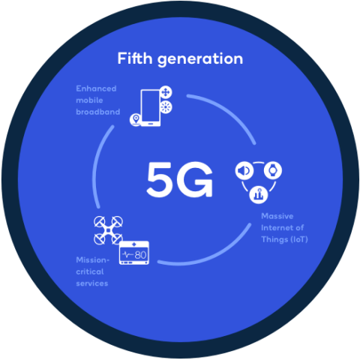
Network Types
1G
Voice oriented system based on analogue technology
2G
Voice oriented system based on digital technology (GSM)
3G
High speed voice oriented with integration of data services (GPRS, CDMA, HSPA)
4G
Data oriented for mobile web access, IP telephony, video services (LTE)
5G
Data-oriented designed for ultra low latency and massive network capacity

Slide 23
Wireless and Mobility
Two important concepts and challenges in networks
Wireless
Communication of wireless link
Mobility
Handling the mobile user who changes point of attachment to network
“Handover”

Slide 24
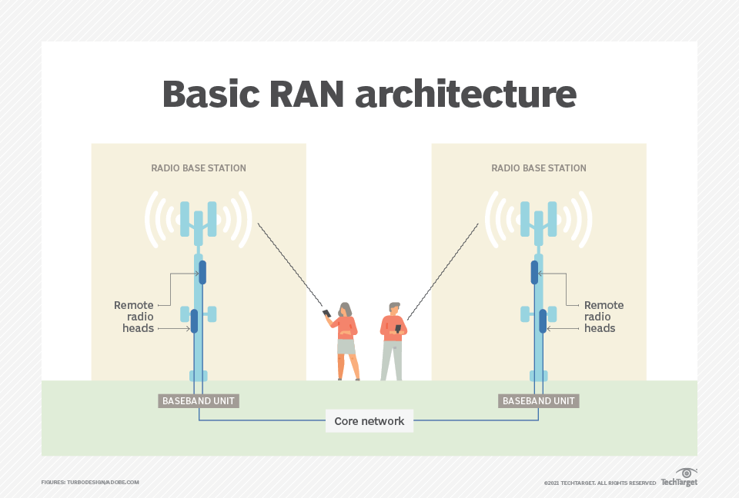
Radio Access Network (RAN)
Is part of an overall telecommunications system
Resides between the user equipment and the core network
There are different types of RAN
GRAN – GSM radio access network
GERAN – same as GRAN, but includes EDGE packet services
UTRAN – UMTS radio access network
E-UTRAN – LTE high speed radio access network
Notes:
ANs have evolved from the first generation (1G) to the fifth generation (5G) of cellular networking. With the development of fourth generation (4G) technology in the 2000s, the 3rd Generation Partnership Project introduced Long-Term Evolution (LTE) RAN, and the radio access network and the core network changed significantly. With 4G, system connectivity for the first time was based on the Internet Protocol (IP), replacing the previous circuit-based networks.
What components make up a RAN?
RAN components include base stations and antennas that cover a specific region, depending on their capacity. Silicon chips in both the core network and the user equipment provide RAN functionality.
A RAN is made up of three essential elements:
Antennas convert electrical signals into radio waves.
Radios transform digital information into signals that can be sent wirelessly and ensure that transmissions are in the correct frequency bands with the right power levels.
Baseband units (BBUs) provide a set of signal processing functions that make wireless communication possible. Traditional baseband uses custom electronics combined with multiple lines of code to enable wireless communication, typically using the licensed radio spectrum. BBU processing detects errors, secures the wireless signal and ensures that wireless resources are used effectively.
How does a RAN work?
A RAN provides access to and coordinates the management of resources across the radio sites. A handset or other device is wirelessly connected to the backbone, or core network, and the RAN sends its signal to various wireless endpoints so it can travel with traffic from other networks. A single handset or phone could be connected at the same time to multiple RANs, sometimes called dual-mode handsets.
In second generation (2G) and third generation (3G) RAN architecture, the RAN controller manages the nodes connected to it. The RAN's network controller -- which manages radio resources, mobility and data encryption -- connects to the circuit-switched core network and the packet-switched core network, depending on the type of RAN.
With the advent of 4G LTE and an all-IP network, the layout of the radio access network has changed. In particular, the introduction of C-RAN has split the radios and antennas from the baseband controller to adapt better to the modern demands of mobile devices.
Today, RAN architecture divides the user plane and the control plane into separate elements. The RAN controller can exchange one set of user data messages through a software-defined networking switch and a second set through a control-based interface. This separation enables the RAN to be more flexible, accommodating the network functions virtualization techniques, such as network slicing and high MIMO, that are necessary for 5G.

Slide 25
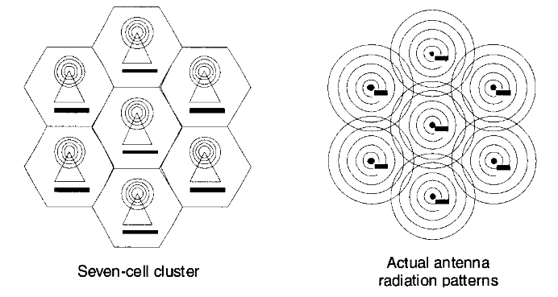
Cellular Networks
Cell
A geographical unit of a cellular network
Is the area immediately around an antenna
Has a specific range and frequency
Usually represented as a hexagonal shape, but in reality, it is irregular shaped.
Cell Hierarchy
Femtocells – smallest, a few metres – up to a km (optimal)
Picocells – tens of metres
Microcells – hundreds of metres
Macrocells - kilometres
Megacells – hundreds of kilometres

Slide 26
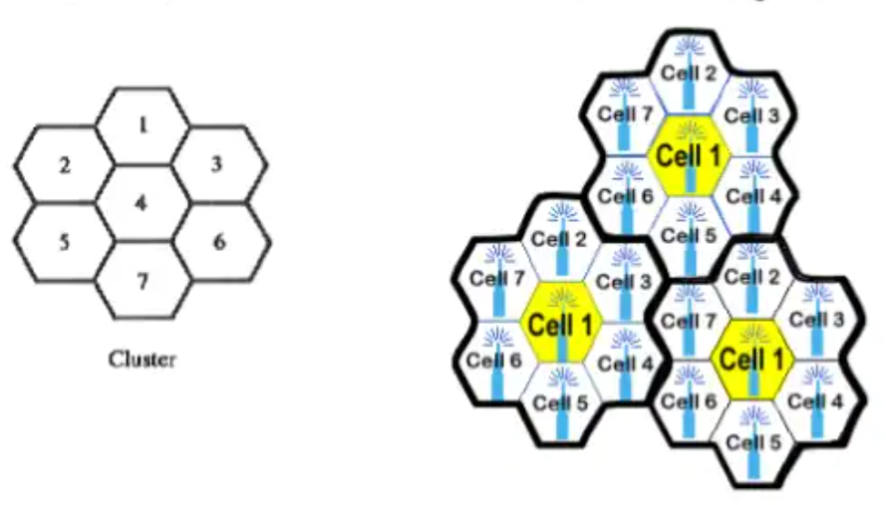
Frequency Reuse
Frequency reuse is a scheme used in mobile networks where frequency channels are reused by neighbouring cells.
Each Base Station is allocated a group of radio channels to be used within a geographic area.
The process of selecting a channel is called Frequency reuse.
Advantages
Improves QoS
Protection against interference
Better use of network resources

Slide 27
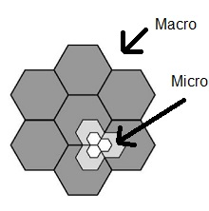
Cell Splitting
As a cell becomes full of users (congested), it can be split into smaller cells.
The smaller cells are reduced in size and transmitter power.
New cells have additional capacity due to additional frequency channels per area.
Used in urban centres with high traffic density
Advantages
Improves capacity of network
Improves performance
But
Handoff is more frequent
Channel assignment becomes difficult.
Notes:
Cell splitting is the process of subdividing a congested cell into smaller cells, each with its own base station and a corresponding reduction in antenna height and transmitter power. Cell splitting increases the capacity of a cellular system since it increases the number of times that channels are reused. By defining new cells which have a smaller radius than the original cells and by installing these smaller cells (called microcells) between the existing cells, capacity increases due to the additional number of channels per unit area [8]. The consequence of the cell splitting is that the frequency assignment has to be done again, which affects the neighboring cells. It also increases the handoff rate because the cells are now smaller and a mobile is likely to cross cell boundaries more often compared with the case when the cells are big. Because of altered signaling conditions, this also affects the traffic in control channels [9]. A typical example of cell splitting is shown in Figure 2. Here, it is assumed that the cell cluster is congested and as a result, the call blocking Imagine if every cell in the cluster was reduced in such a way that the radius, R of every cell was cut in half, (R/2). In order to cover the entire service area with smaller cells, approximately four times as many cells would be required. The increased number of cells would increase the number of clusters over the coverage region, which in turn would increase the number of channels, and thus capacity, in the coverage area. In the example shown in Figure 2, the smaller cells were added in such a way as to preserve the frequency reuse plan of the system. In this case, the radius of each new microcell is half that of the original cell.

Slide 28
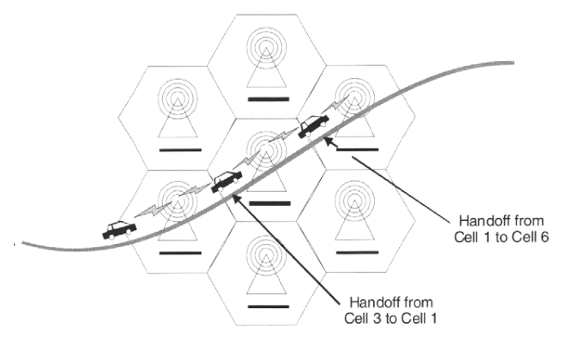
Handoff (mobility)
Since adjacent cells do not share a frequency, a problem occurs as a subscriber travels from one cell to another
Call must be dropped or transferred to another cell.
Dropped call is unacceptable
As the subscriber travels out of coverage area, the signal becomes weaker
Cell site requests a handoff
Network will initiate a switch to a stronger cell signal without interrupting call/data transmission
Notes:
A problem is created when a mobile subscriber travels from one cell to another during a call. Since adjacent cells do not use the same channels (frequencies) a call must either be dropped or transferred from one channel to another when a user crosses the line between cells. Since dropping is unacceptable, a handoff process was created whereby the mobile telephone network automatically transfers the call from one channel to another as the mobile crosses over into an adjacent cell (Figure 10.5). During a call, two parties are on one voice channel. When the mobile unit moves out of the coverage area of a given cell the reception becomes weak and the cell site in use requests a handoff. The system switches the call to a stronger channel on a new site without interrupting the call or alerting the user
https://www.youtube.com/watch?v=lSwRfjgUYqQ

Slide 29
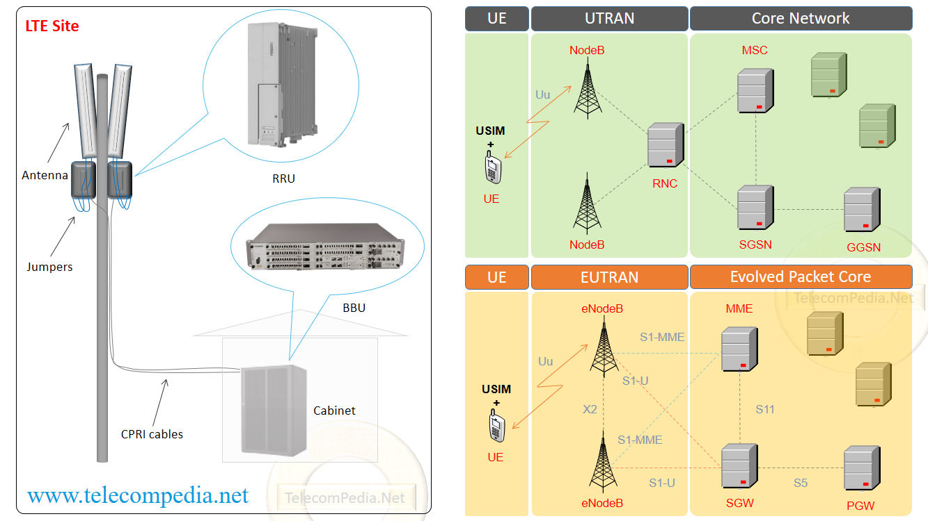
Exercise:
Take 5 minutes and do some research.
How does a phone make a call?
E.g. Phone A will call Phone B?
Answer:
It depends on the network
GSM/UMTS/LTE all use different methods
But, generally
UE > RAN > Core Network > RAN > UE

Slide 30
Current Mobile Network Generations
GSM, GPRS, UMTS/HSPA, LTE

Slide 31
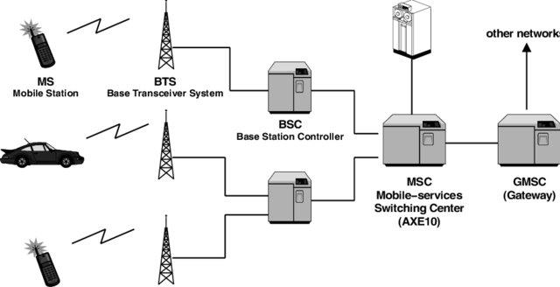
Global system for Mobile Communication (GSM)
Components of GSM network
User Equipment (mobile Station)
Base Station subsystem (BSS)
BTS - Base Transceiver station
BSC - Base station Controller
Network Switching subsystem
MSC – Mobile Switching Centre
HLR – Home Location Register
VLR – Visitor Location Register
AUC – Authentication Centre
EIR – Equipment Identity Registry
Notes:
The Base Transceiver Station (BTS)
The BTS houses the radio transceivers that define a cell and handles the radio link protocols with the MS. In a large urban area, a large number of BTSs may be deployed.
The BTS corresponds to the transceivers and antennas used in each cell of the network. A BTS is usually placed in the center of a cell. Its transmitting power defines the size of a cell. Each BTS has between 1 and 16 transceivers, depending on the density of users in the cell. Each BTS serves as a single cell. It also includes the following functions −
Encoding, encrypting, multiplexing, modulating, and feeding the RF signals to the antenna
Transcoding and rate adaptation
Time and frequency synchronizing
Voice through full- or half-rate services
Decoding, decrypting, and equalizing received signals
Random access detection
Timing advances
Uplink channel measurements
The Base Station Controller (BSC)
The BSC manages the radio resources for one or more BTSs. It handles radio channel setup, frequency hopping, and handovers. The BSC is the connection between the mobile and the MSC. The BSC also translates the 13 Kbps voice channel used over the radio link to the standard 64 Kbps channel used by the Public Switched Telephone Network (PSDN) or ISDN.
It assigns and releases frequencies and time slots for the MS. The BSC also handles intercell handover. It controls the power transmission of the BSS and MS in its area. The function of the BSC is to allocate the necessary time slots between the BTS and the MSC. It is a switching device that handles the radio resources.
The additional functions include−
Control of frequency hopping
Performing traffic concentration to reduce the number of lines from the MSC
Providing an interface to the Operations and Maintenance Center for the BSS
Reallocation of frequencies among BTSs
Time and frequency synchronization
Power management
Time-delay measurements of received signals from the MS
Home Location Register (HLR)
The HLR is a database used for storage and management of subscriptions. The HLR is considered the most important database, as it stores permanent data about subscribers, including a subscriber's service profile, location information, and activity status. When an individual buys a subscription in the form of SIM, then all the information about this subscription is registered in the HLR of that operator.
Mobile Services Switching Center (MSC)
The central component of the Network Subsystem is the MSC. The MSC performs the switching of calls between the mobile and other fixed or mobile network users, as well as the management of mobile services such as registration, authentication, location updating, handovers, and call routing to a roaming subscriber. It also performs such functions as toll ticketing, network interfacing, common channel signaling, and others. Every MSC is identified by a unique ID.
Visitor Location Register (VLR)
The VLR is a database that contains temporary information about subscribers that is needed by the MSC in order to service visiting subscribers. The VLR is always integrated with the MSC. When a mobile station roams into a new MSC area, the VLR connected to that MSC will request data about the mobile station from the HLR. Later, if the mobile station makes a call, the VLR will have the information needed for call setup without having to interrogate the HLR each time.
Authentication Center (AUC)
The Authentication Center is a protected database that stores a copy of the secret key stored in each subscriber's SIM card, which is used for authentication and ciphering of the radio channel. The AUC protects network operators from different types of fraud found in today's cellular world.
Equipment Identity Register (EIR)
The Equipment Identity Register (EIR) is a database that contains a list of all valid mobile equipment on the network, where its International Mobile Equipment Identity (IMEI) identifies each MS. An IMEI is marked as invalid if it has been reported stolen or is not type approved.

Slide 32
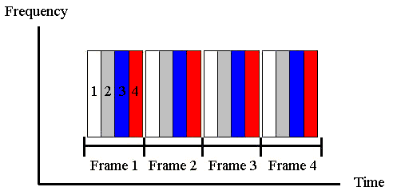
What is GSM?
GSM as a 2nd generation standard (2G)
Widely used all over the world
Uses TDMA mostly
Evenly divides time between a number of users on network
Separated into finite length frames
Must wait until next transmission slot
Only one user transmits at a time
But
Idle users waste network resources as their slots are not redistributed

Slide 33
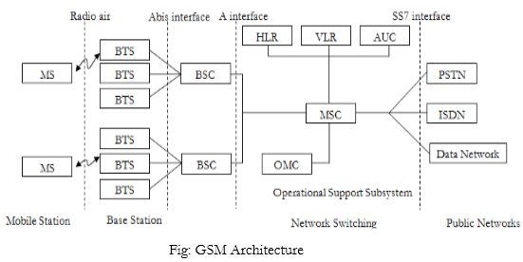
Sample GSM originating call
Subscriber dials the receiver number and sends it to BTS
BTS sends it to its BSC
BSC forwards to the MSC
MSC looks up HLR for subscriber information
MSC routes call to receiver MSC
MSC sends to BSC and then to BTS
Communication with receiver is established
Notes:
A call originating from a mobile device (MS) in the GSM network is routed through the core network to the destination party. To connect to the GSM network, an MS first connects to a radio network, which is in charge of handling messaging between devices and the core network. An MS is constantly communicating with the Base Station Subsystem of the radio network to send and receive signals. The steps to establishing a GSM voice call are illustrated below.
o initiate a call, the MS sends a request for radio resource allocation to the BSS, which mediates further connection to the Mobile Switching Center (MSC). The BSS assigns the MS a channel with a given frequency and time slot, which constitutes the communication route between the MS and the BSS.
once the MS confirms the established channel, the BSS can initiate the connection to the MSC.
once the MS has connected to the network, the subscriber needs to be authenticated. This can be done using the IMSI number stored in the SIM card, which allows the Authentication Center in the core network to verify the subscriber’s identity. After this step, the MS and the MSC can start communicating.
To make sure the data sent over the radio network between the BSS and MS/MSC is secure, the MSC initiates a ciphering procedure which is transmitted to the BTS, which in turn forwards the message to the MS. The MS enables ciphering towards the BTS; as the BTS starts receiving ciphered data, it will start the ciphered transmission of information, finalizing the encryption procedure.
4. in order to initiate the call setup, the MSC verifies that the requested service is allowed for the subscriber. This information is available in the Virtual Location Register, which maintains temporary subscriber data (location, preferences, allowed services). Once the VLR confirms the service requested by the originating MS, the MSC starts the call setup.
5. for the call to take place, the MSC allocates a voice channel between the MSC and the BSS. The BSS notifies the MS about the change to voice mode, and the MS returns a confirmation message. The MSC routes the call to the dialled number. When the call is received in the PSTN, the MSC is notified that the called subscriber is being alerted, at which point the originating MS receives a ring notification.
To disconnect the call by either party, a disconnect message is sent to the MSC, which releases the communication channels created with the PSTN and the BSS.

Slide 34
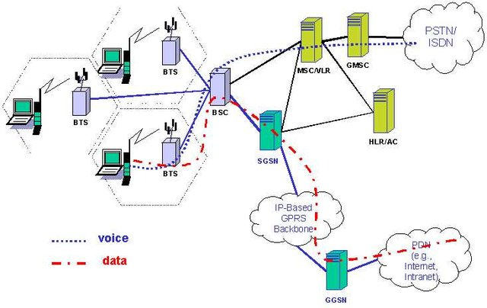
General Packet Radio Service (GPRS)
GPRS is an add-on to GSM
Allowed packet switched data over a GSM network
GSM is circuit switched network
Allowed data transmission in addition to voice and messaging
It is best effort packet delivery – no QoS
Max data rate of 171.2Kbps
New Nodes:
SGSN
GGSN
Sometimes called 2.5G
Notes:
Task of SGSN :
Packet Delivery
Mobility management
apply/ sign off of terminals
localization
LLC (Logical Link Control) management
Authentication
Billing
Task of GGSN :
Mediator between GPRS between backbone and external data networks.
Saves current data for the SGSN address of the participant as well as their profile and data for authentication and invoice.

Slide 35
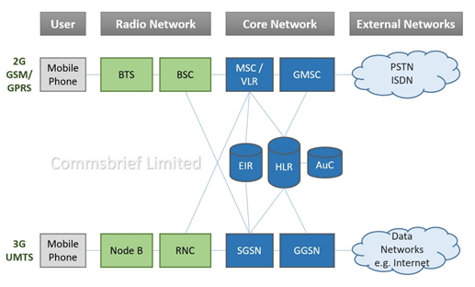
Universal Mobile Telecommunications System (3G)
UMTS is a 3rd Generation mobile network standard based on the GSM standard. – commonly referred to as 3G
Three main parts
User Equipment
RAN
Core Network
Mainly WCDMA based
Uses Higher frequency
Packet Switched based network
New Nodes
NodeB – new version of Radios
RNC – Replaced BSC
Notes:
https://commsbrief.com/difference-between-gsm-umts-lte/
UMTS was the 3G migration path for GSM networks. The air interface for UMTS is based on Wideband Code Division Multiple Access (WCDMA) which is different from FDMA and TDMA that GSM employed. 3G UMTS migration required major upgrades to the radio network as new base stations were needed. The UMTS mobile core network used the same packet-switched network nodes, SGSN and GGSN that were introduced as part of the GPRS upgrade. The customers required new mobile phones in order to be able to access the new UMTS technology. Since UMTS networks were designed to co-exist with the GSM networks, they were well-integrated to ensure that inter-technology handovers (IRAT – Inter Radio Access Technology) could occur seamlessly. UMTS networks can enable theoretical peak speeds of up to 2 Mbps and real-life speeds of around 384 kbps. These speeds were further improved by later enhancements High-Speed Downlink Packet Access (HSDPA) and High-Speed Uplink Packet Access (HSUPA). HSDPA and HSUPA are collectively called HSPA (High-Speed Packet Access) which can enable peak downlink and uplink speeds of up to 14.4 Mbps and 5.76 Mbps, respectively. HSPA was followed by HSPA+ or Evolved High-speed Packet Access, which improves peak speeds to 42 Mbps in the downlink and 11.5 Mbps in the uplink. You can check out our dedicated post on 3G UMTS networks for a detailed view, including UMTS frequencies, channel bandwidth and more.

Slide 36
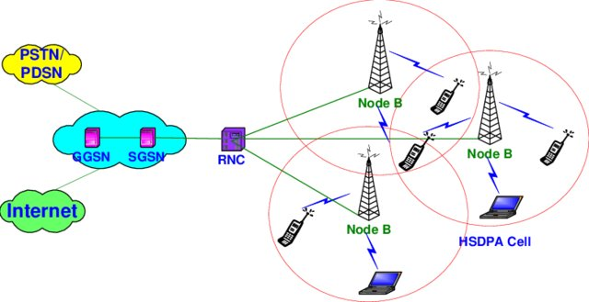
High Speed Packet Access (+)
Improvement to UMTS to allow higher speeds
UMTS – peak of 2Mbps
HSPA – peak of 14.4Mbps
HSPA+
Further improvement to allow higher speeds
HSPA+ - peak of 42Mbps
Notes:
What Does UMTS Mean For An Average Phone User?
The 3G UMTS networks allowed mobile phone users to enjoy bit rates of up to 384 kbps, which was higher than the data rates 2G GSM networks could enable. UMTS networks can enable maximum theoretical bit rates of up to 2 Mbps. Before the launch of UMTS, the GSM EDGE enhancement (shown on the mobile phone as the E symbol) offered theoretical download speeds of up to 384 kbps, but the real-life average was between 130-200 kbps. For GSM customers, UMTS meant buying a new phone that could work with the new WCDMA standard. UMTS is the technology that led to the introduction of High-Speed Packet Access (HSPA) which we normally see on mobile phones as the H or H+ symbol like the picture below.
What Is The Difference Between UMTS And HSPA?
UMTS networks provided the 3G technology as part of 3GPP Release 1999 that saw the introduction of HSPA in later 3GPP releases. UMTS is the main underlying technology supporting voice, text and data, but HSPA enhances data by enabling high-speed download and upload speeds. HSPA is a combination of HSDPA (High-Speed Downlink Packet Access) and HSUPA (High-Speed Uplink Packet Access). It can offer peak download speeds of up to 14.4 Mbps and peak uploads of up to 5.76 Mbps. With Evolved HSPA (HSPA+), the peak data rates improved to 42 Mbps for downloads and 11.5 Mbps for uploads. Check out our dedicated post on HSPA for more information.
What Is The Difference Between UMTS And LTE?
LTE or Long Term Evolution of mobile networks is a fourth-generation technology that provides a 4G migration path to third-generation UMTS and CDMA2000 networks. To be clear, 4G LTE networks did not replace 3G UMTS but rather co-existed so that when a phone user is in an area where LTE coverage is not available, they can still access the mobile network through 3G UMTS. The most noticeable difference for an average phone user is the speed; the original LTE networks can provide average download speeds of between 15-20 Mbps (in the UK). The advanced LTE networks can provide average speeds of around 15-80 Mbps (UK). The peak speeds with LTE networks are much higher than 3G networks, which you can learn more about in our dedicated post on LTE and LTE-Advanced.

Slide 37
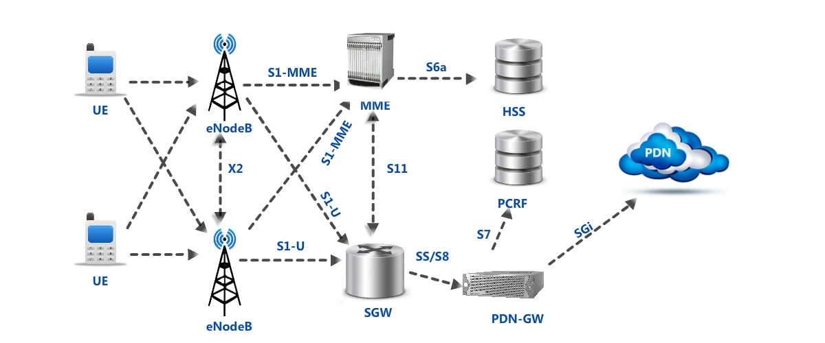
Long Term Evolution (4G)
4th Generation of mobile networks
Significant departure from previous generations
4G was enabled by LTE standards
Based on OFDMA
New Nodes
RAN
eNodeB (MIMO)
EPC
MME
SGW
PGW
PCRF
HSS
Notes:
OFDMA is an updated version of frequency-division multiplexing (FDM) technology used to divide packets of information into separate bands that are carried by separate signals. This form of communication is an upgrade that parallels the switch of internet carriers to Wi-Fi 6 wireless, as well as the upgrade of phone carriers to 4G and 5G LTE. Instead of the traditional analog modulation used in multiplexing, OFDMA uses carrier signal waves, called subcarriers, to move small bits of information in a more streamlined fashion.
Advantages and disadvantages of OFDMA
Implementing OFDMA can provide the following advantages:
Higher diversity and efficiency of frequency
Provides lower interference between cells.
More flexibility as channels and sub-channels can be toggled on and off.
Better coverage over networks.
However, potential disadvantages include:
The diversity of frequencies is conditional on how subcarriers are assigned to users, and can thus become very complex.
Requires extra power because it is always on and ready to send a transmission.
Has a higher sensitivity than other channel types.
https://sites.google.com/site/lteencyclopedia/lte-network-infrastructure-and-elements
.2 eNode Bs: The Single E-UTRAN Node
Compared with UTRAN, the E-UTRAN OFDM-based structure is quite simple. It is only composed of one network element: the eNodeB (for evolved Node B.). The 3G RNC (Radio Network Controller) inherited from the 2G BSC (Base Station Controller) has disappeared from E-UTRAN and the eNodeB is directly connected to the Core Network using the S1 interface. As a consequence, the features supported by the RNC have been distributed between the eNodeB or the Core Network MME or Serving Gateway entities.
The EPC (Evolved Packet Core) is composed of several functional entities:
• The MME (Mobility Management Entity)
• The HSS (Home Subscriber Server)
• The Serving Gateway.
• The PDN Gateway (Packet Data Network).
• The PCRF (Policy and Charging Rules Function) Server.
3.1 MME (Mobility Management Entity)
The MME is in charge of all the Control plane functions related to subscriber and session management. From that perspective, the MME supports the following:
• Security procedures – this relates to end-user authentication as well as initiation and negotiation of ciphering and integrity protection algorithms.
• Terminal-to-network session handling – this relates to all the signalling procedures used to set up Packet Data context and negotiate associated parameters like the Quality of Service.
• Idle terminal location management – this relates to the tracking area update process used in order for the network to be able to join terminals in case of incoming sessions.
The MME is linked through the S6 interface to the HSS which supports the database containing all the user subscription information.
3.2 HSS (Home Subscriber Server)
The HSS (Home Subscriber Server) is the concatenation of the HLR (Home Location Register) and the AuC (Authentication Center) – two functions being already present in pre-IMS 2G/GSM and 3G/UMTS networks. The HLR part of the HSS is in charge of storing and updating when necessary the database containing all the user subscription information, including (list is non exhaustive):
• User identification and addressing – this corresponds to the IMSI (International Mobile Subscriber Identity) and MSISDN (Mobile Subscriber ISDN Number) or mobile telephone number
• User profile information – this includes service subscription states and user-subscribed Quality of Service information (such as maximum allowed bit rate or allowed traffic class).
The AuC part of the HSS is in charge of generating security information from user identity keys. This security information is provided to the HLR and further communicated to other entities in the network. Security information is mainly used for:
• Mutual network-terminal authentication.
• Radio path ciphering and integrity protection, to ensure data and signalling transmitted between the network and the terminal is neither eavesdropped nor altered.
3.3 The Serving GW (Serving Gateway)
From a functional perspective, the Serving GW is the termination point of the packet data interface towards E-UTRAN. When terminals move across eNodeB in E-UTRAN, the Serving GW serves as a local mobility anchor, meaning that packets are routed through this point for intra E-UTRAN mobility and mobility with other 3GPP technologies, such as 2G/GSM and 3G/UMTS.
3.4 The PDN GW (Packet Data Network Gateway)
Similarly to the Serving GW, the PDN gateway is the termination point of the packet data interface towards the Packet Data Network. As an anchor point for sessions towards the external Packet Data Networks, the PDN GW also supports Policy Enforcement features (which apply operator-defined rules for resource allocation and usage) as well as packet filtering (like deep packet inspection for virus signature detection) and evolved charging support (like per URL charging).
3.5 The PCRF (Policy and Charging Rules Function) Server
The PCRF server manages the service policy and sends QoS setting information for each user session and accounting rule information. The PCRF Server combines functionalities for the following two UMTS nodes:
• The Policy Decision Function (PDF)
• The Charging Rules Function (CRF)
The PDF is the network entity where the policy decisions are made. As the IMS session is being set up, SIP signalling containing media requirements are exchanged between the terminal and the P-CSCF. At some time in the session establishment process, the PDF receives those requirements from the P-CSCF and makes decisions based on network operator rules, such as:
• Allowing or rejecting the media request.
• Using new or existing PDP context for an incoming media request.
• Checking the allocation of new resources against the maximum authorized
The CRFs role is to provide operator-defined charging rules applicable to each service data flow. The CRF selects the relevant charging rules based on information provided by the P-CSCF, such as Application Identifier, Type of Stream (audio, video, etc.), Application Data Rate, etc.

Slide 38
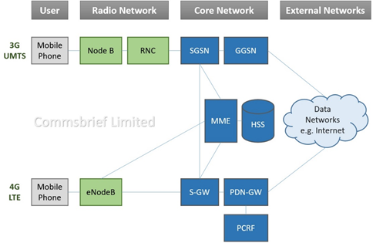
3G and 4G co-existence
4G towers backward compatible
MME can communicate with UMTS nodes
SGSN
GGSN
Notes:
MME (Mobility Management Entity)
The MME is in charge of all the Control plane functions related to subscriber and session management

Slide 39

Questions?

